Slide 1
Manchester
Raspberry Jam 28
April 2015

Slide 2
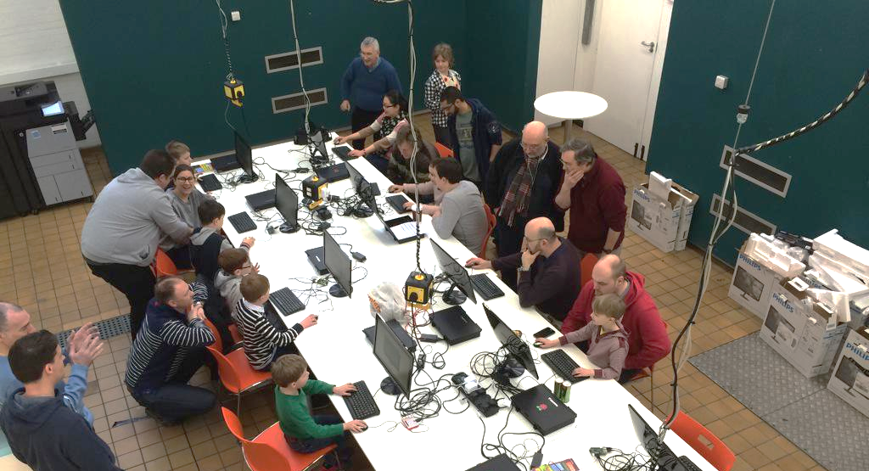
Last Time

Slide 3

Today:
11:00 - Introduction to Minecraft (Repeat)
13:00 - Lunch
14:00 -
15:30 - Circles, spheres and cylinders in Minecraft

Slide 4
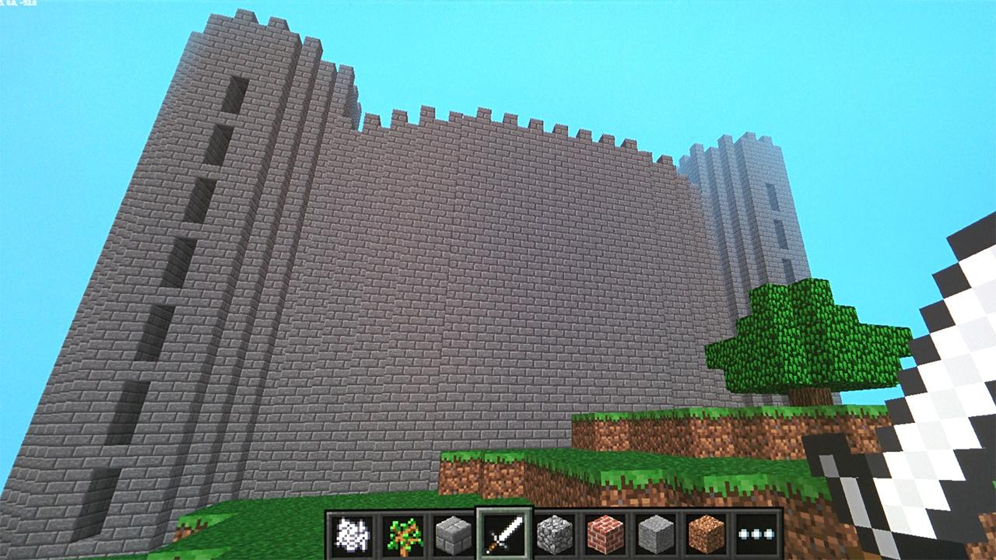

Slide 5
Today:
11:00 - Introduction to Minecraft (Repeat)
13:00 - Lunch
14:00 - Storm the Castle
15:30 - Circles, spheres and cylinders in Minecraft
WiFi:
SSID MMU-Visitor
Pass. University
Next Month’s Jam:
Saturday 16th May
Slides and other downloads at: bit.ly/mcraspjam

